Slide 1
Hash Maps, Stacks and Queues
Chidera Anichebe
dera@ieee.org

Slide 2
What is a Hashmap?
A Hashmap is a data structure which stores data in an associative manner. In a hashmap, data is stored in an array format, where each data value has its own unique index value. Access of data becomes very fast if we know the index of the desired data.
Thus, it becomes a data structure in which insertion and search operations are very fast irrespective of the size of the data. A hashmap uses an array as a storage medium and uses hash technique to generate an index where an element is to be inserted or is to be located from.

Slide 3
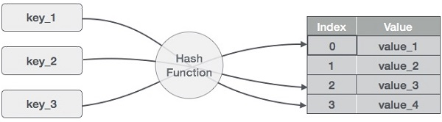
What is hashing?
Hashing is a technique to convert a range of key values into a range of indexes of an array.
Hashing is an example of a space-time tradeoff. If memory is infinite, the entire key can be used directly as an index to locate its value with a single memory access. On the other hand, if infinite time is available, values can be stored without regard for their keys, and a binary search or linear search can be used to retrieve the element

Slide 4
Basic operations of a hashmap
The following are the basic primary operations of a hashmap:
Search – Searches an element in a hashmap
Insert – Inserts an element in a hashmap
Delete – Deletes an element from a hashmap

Slide 5
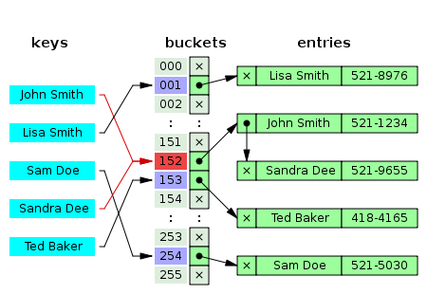
Collision resolution
A search algorithm that uses hashing consists of two parts. The first part is computing a hash function which transforms the search key into an array index. The ideal case is such that no two search keys hashes to the same array index. However, this is not always the case and is impossible to guarantee for unseen given data. Hence the second part of the algorithm is collision resolution. The two common methods for collision resolution are separate chaining and open addressing:
- Separate chaining: this process involves building a linked list with key–value pair for each search array index.
- Open addressing: this is another collision resolution technique in which every entry records are stored in the bucket array itself, and the hash resolution is performed through probing

Slide 6


What is a Stack?
A stack is an Abstract Data Type (ADT), commonly used in most programming languages. It is named stack as it behaves like a real-world stack, for example – a deck of cards or a pile of plates, etc.
This features makes it a LIFO data structure. LIFO stands for Last-In-First-Out. Here, the element which is placed (inserted or added) last, is accessed first. In stack terminology, insertion operation is called PUSH operation and removal operation is called POP operation

Slide 7
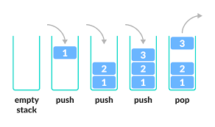
The representation of a Stack
A stack can be implemented by means of an array, struct, pointer or linked list. Stack can either be a fixed size one or it may have a sense of dynamic resizing

Slide 8
Basic operations of a Stack
Stack operations may involve initializing the stack, using it and then de-initializing it. Apart from these basic stuffs, a stack is used for the following two primary operations:
- push() – pushing (storing) an element on the stack
- pop() – removing (accessing) an element from the stack
To use a stack efficiently, we need to check the status of the stack as well using these additional functionality:
- peek() – get the top data element of the stack, without removing it
- isFull() – check if the stack is full
- isEmpty() – check if the stack is empty

Slide 9
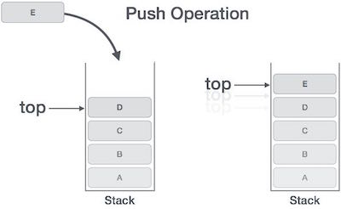
Stack operations
The push operation
The process of putting a new data element onto stack is known as a Push operation. Push operation involves a series of steps:
Step 1 – Checks if the stack is full
Step 2 – If the stack is full, produces an error and exits
Step 3 – If the stack is not full, increments top to point to next empty space
Step 4 – Adds data element to the stack location, where top is pointing
Step 5 – Returns with success

Slide 10
Stack operations
The pop operation
Accessing the content while removing it from the stack, is known as a POP operation. In an array implementation of pop() operation, the data element is not actually removed, instead top is decremented to a lower position in the stack to point to the next value. But in linked-list implementation, pop() actually removes data element and frees memory space.
A pop operation may involve the following steps –
Step 1 – Checks if the stack is empty
Step 2 – If the stack is empty, produces an error and exits
Step 3 – If the stack is not empty, accessed the data element at which top is pointing
Step 4 – Decreases the value of top by 1
Step 5 - Returns gracefully with success

Slide 11
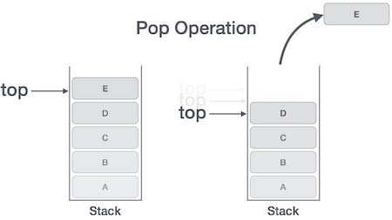
Stack pop() operation pictorially

Slide 12
Applications of the Stack ADT
Why should we care?
The stack is a last-in, first-out data structure. The developer can use the stack in the following use cases:
Expression evaluation and syntax parsing
Finding the correct path in a maze using backtracking
Runtime memory management
Recursion function

Slide 13

What is a Queue?
A queue is an abstract data structure, somewhat similar to stacks. One end is always used to insert data (enqueue) and the other is used to remove data (dequeue). Queue follows First-In-First-Out methodology i.e., the data item stored first will be accessed first.

Slide 14
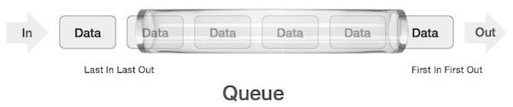
The representation of a Queue
As we now understand that in queue, we access both ends for different reasons. The diagram below tries to explain queue representation as a data structure. Queues can also be implemented using Arrays, Linked Lists, Pointers and Structs

Slide 15
Basic operations of a Queue
Queue operations may involve initializing or defining the queue, utilizing it, and then completely erasing it from the memory. Here we shall try to understand the basic operations associated with queues:
enqueue() – add (store) an item to the queue
dequeue() – remove (access) an item from the queue
Few more functions are required to make the above-mentioned queue operation efficient. These are:
peek() – gets the element at the front of the queue without removing it
isfull() – checks if the queue is full
isempty() – checks if the queue is empty
In queue, we always dequeue (or access) data, pointed by front pointer and while enqueuing (or storing) data in the queue we take help of rear pointer

Slide 16
Queue operations
The enqueue operation
Queues maintain two data pointers, front and rear. Therefore, its operations are comparatively difficult to implement than that of stacks.
The following steps should be taken to enqueue (insert) data into a queue:
Step 1 – Check if the queue is full
Step 2 – If the queue is full, produce overflow error and exit
Step 3 – If the queue is not full, increment rear pointer to point to the next empty space
Step 4 – Add data element to the queue location, where the rear is pointing
Step 5 – Return success

Slide 17
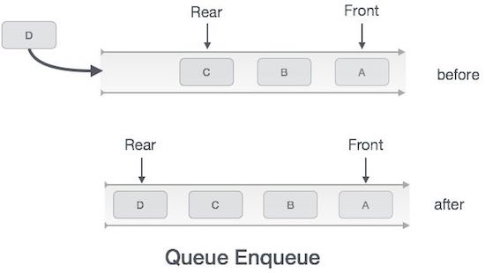
Queue enqueue() operation pictorially

Slide 18
Queue operations
The dequeue operation
Accessing data from the queue is a process of two tasks – access the data where front is pointing and remove the data after access. The following steps are taken to perform dequeue operation:
Step 1 – Check if the queue is empty
Step 2 – If the queue is empty, produce underflow error and exit
Step 3 – If the queue is not empty, access the data where front is pointing
Step 4 – Increment front pointer to point to the next available data element
Step 5 – Return gracefully with success

Slide 19
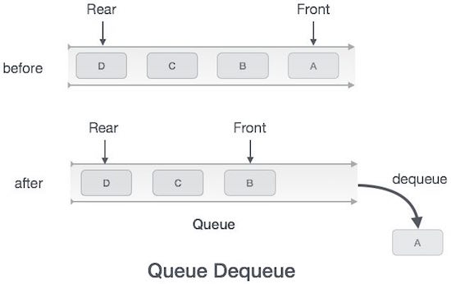
Queue dequeue() operation pictorially

Slide 20
Applications of the Queue ADT
Why should we care?
The queue is a first in, first out (FIFO) data structure. The developer can use Queue in the following use cases:
When you need an order
When you want data processed in First In First Out order
If the developer wants to add or remove both ends, they can use the queue or a double-ended queue

Slide 21
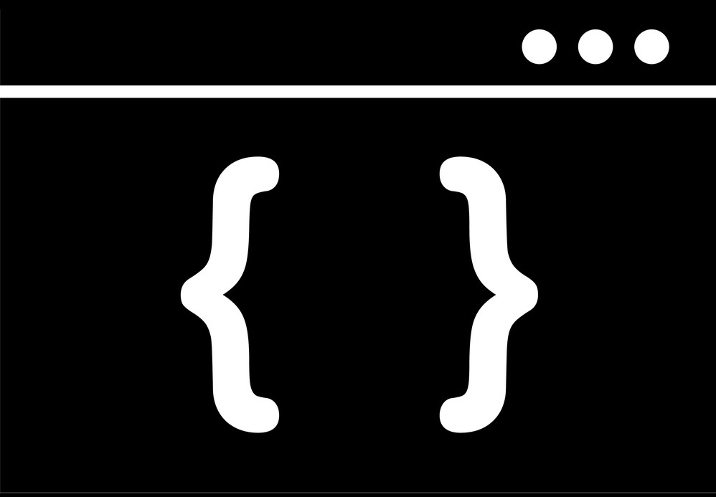
PRACTICAL SESSION…

Slide 22

Questions?

Slide 23




Thank you!
Let’s connect
https://twitter.com/starlingvibe
https://linkedin.com/in/chideraanichebe
https://github.com/starlingvibes

